Slide 1
Play with 3D data: Exploiting additional information for 3D processing
Chaoda Zheng
2020.08.07

Slide 2
Paper list
What You See is What You Get: Exploiting Visibility for 3D Object Detection (CVPR2020)
An LSTM Approach to Temporal 3D Object Detection in LiDAR Point Clouds (ECCV2020)
Virtual Multi-view Fusion for 3D Semantic Segmentation (ECCV2020)

Slide 3
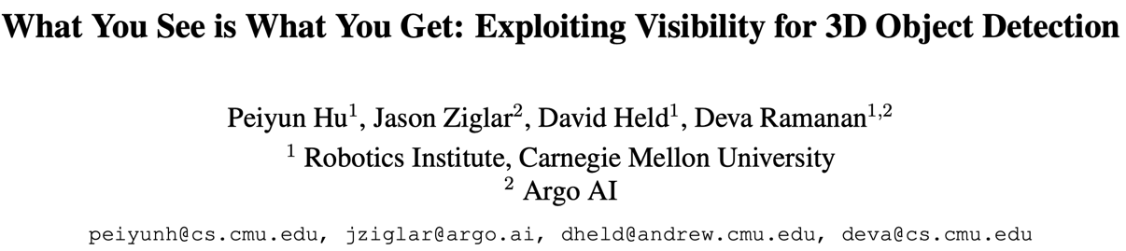

Slide 4
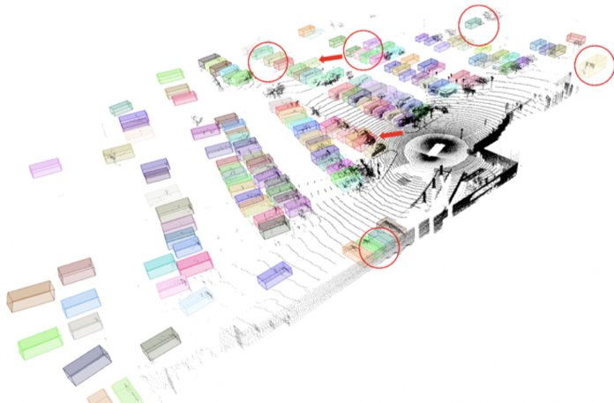
Object Detection in Lidar

Slide 5
Revisiting
What is a good representation for processing 3D sensor data？
Lidar Data != Point Clouds
Representations for processing LiDAR data should embrace visibility
ray
occluded
free
3D point
sensor

Slide 6
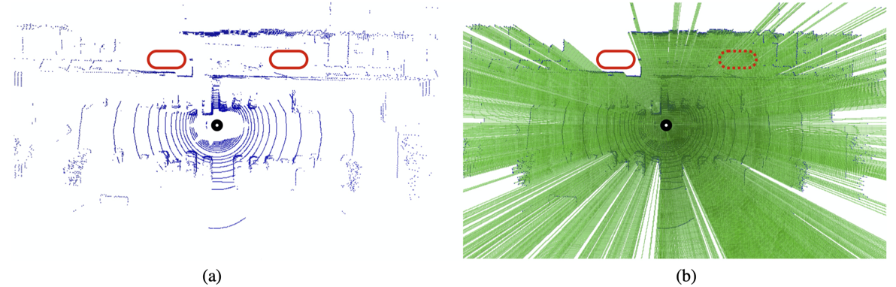
Visibility in Lidar Data
Points
Visibility map

Slide 7
Compute Visibility through Raycasting

Slide 8
Compute Visibility through Raycasting
occupied
free
unknown

Slide 9
Compute Visibility through Raycasting
occupied
free
unknown

Slide 10
Compute Visibility through Raycasting
occupied
free
unknown

Slide 11
Compute Visibility through Raycasting
occupied
free
unknown

Slide 12
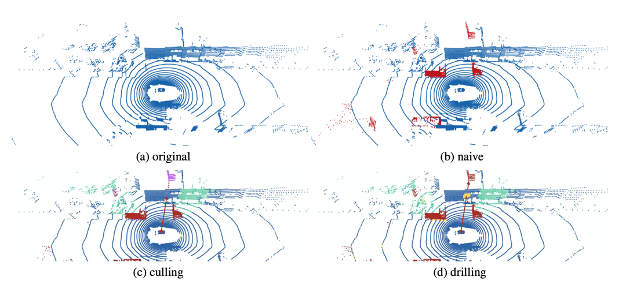
Raycasting with augmented objects
impossible

Slide 13
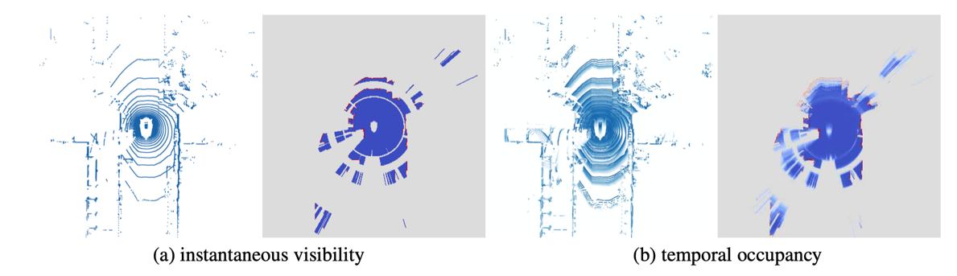
Extend into a temporal context
Turn a 4D spatial-temporal visibility into a 3D posterior probability of occupancy

Slide 14
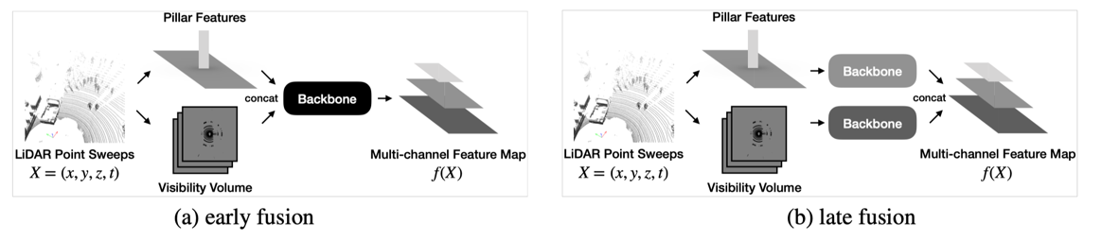
The detection network
adding an additional input stream to PointPillars

Slide 15
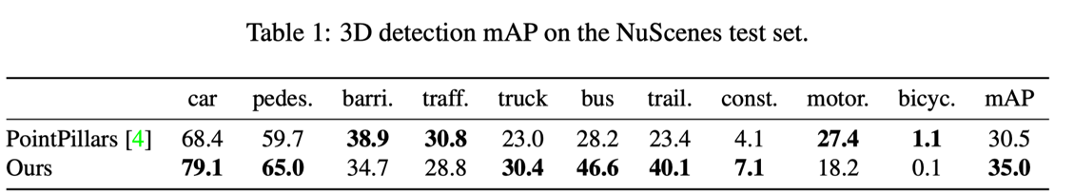
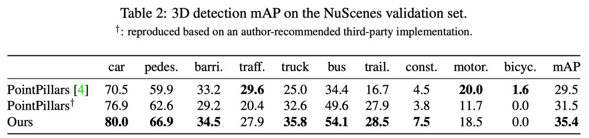
Experiments

Slide 16
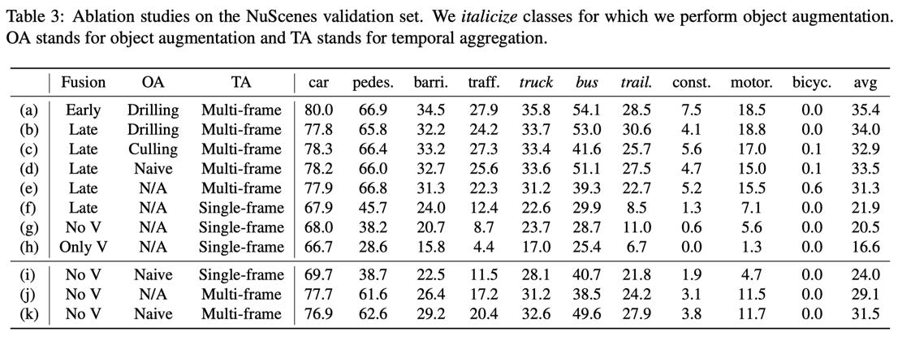
Experiments

Slide 17
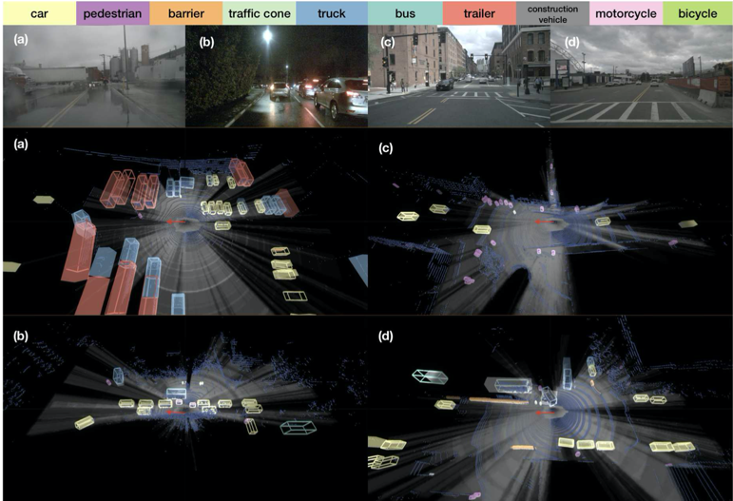
Experiments

Slide 18
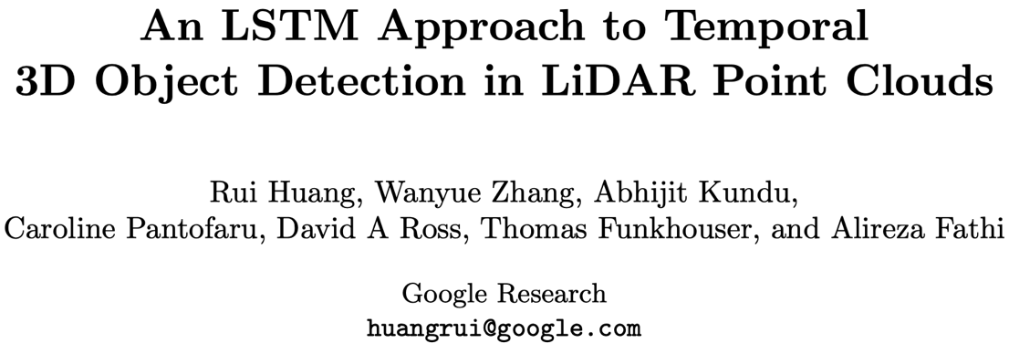

Slide 19
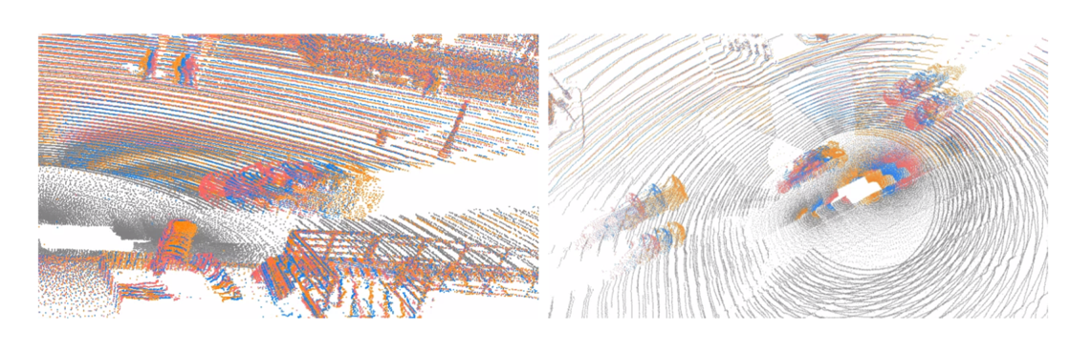
Motivation
Example sequences in Waymo Open Dataset.

Slide 20
Motivation
LiDAR data is acquired over time
Useful information is available in the temporal domain
Previous work：
Consider only one “frame”
Simply concatenate inputs/ reuse seed points for multiple frames

Slide 21
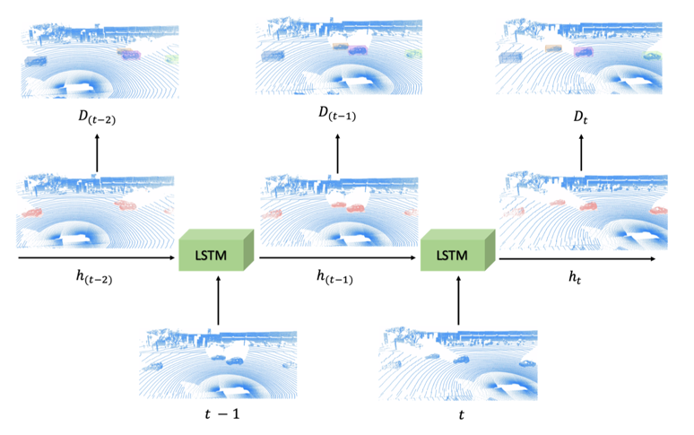
Solution
Using LSTMs for Temporal Learning

Slide 22
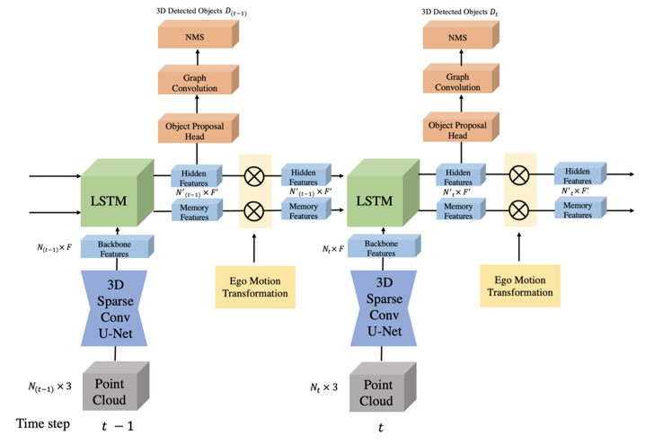
Overview

Slide 23
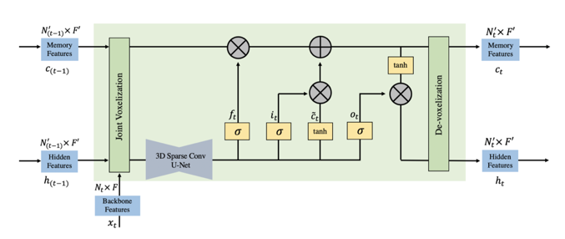
3D Sparse Conv LSTM - the design
Vanilla LSTM
3D Sparse Conv LSTM

Slide 24
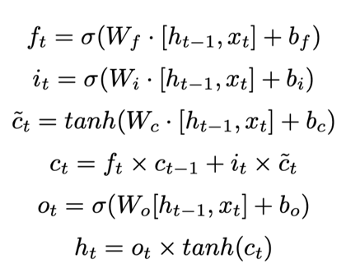
3D Sparse Conv LSTM - the design
Vanilla LSTM

Slide 25
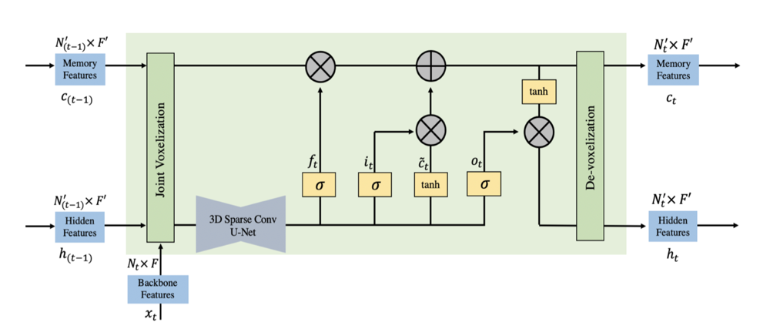
3D Sparse Conv LSTM - the design
FC -> SparseConv

Slide 26
3D Sparse Conv LSTM - the design

Slide 27
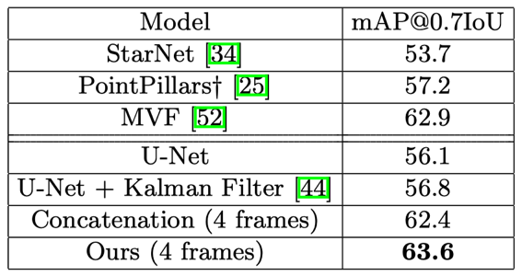
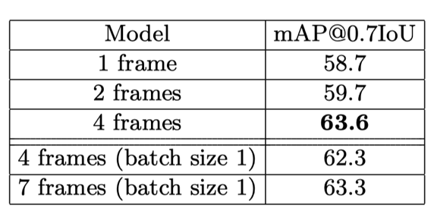
Experiments

Slide 28
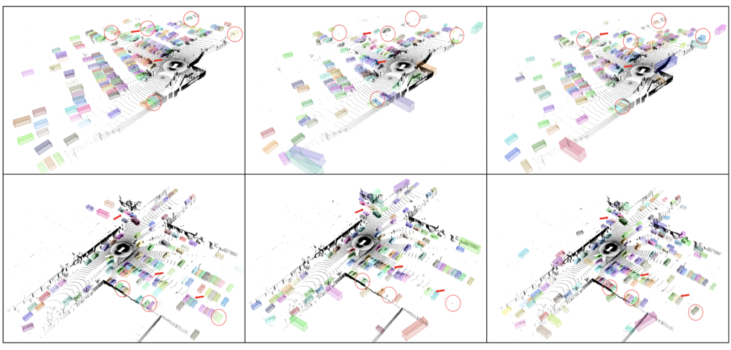
Experiments
GT
Single
LSTM

Slide 29
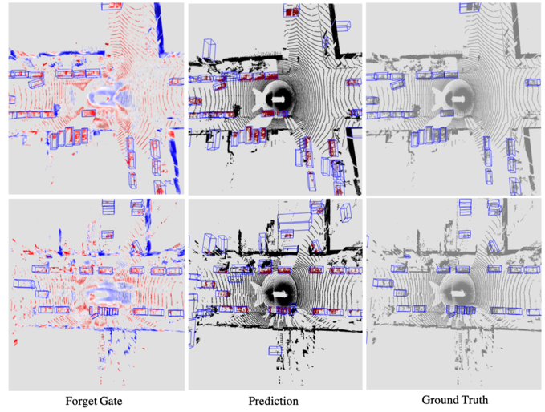
Experiments

Slide 30
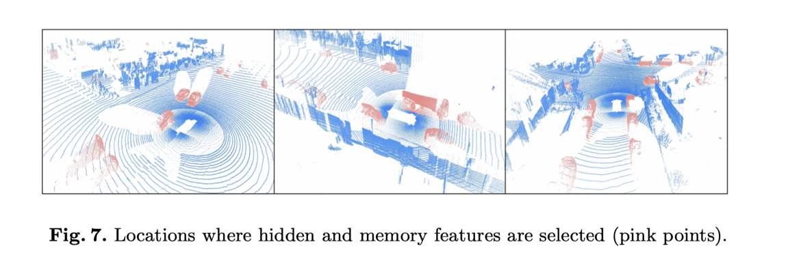
Experiments

Slide 31
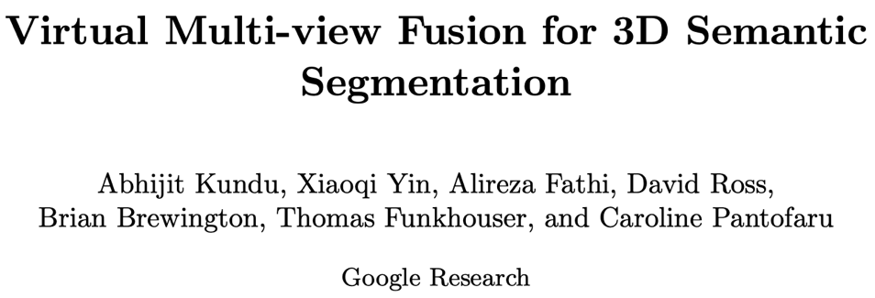

Slide 32
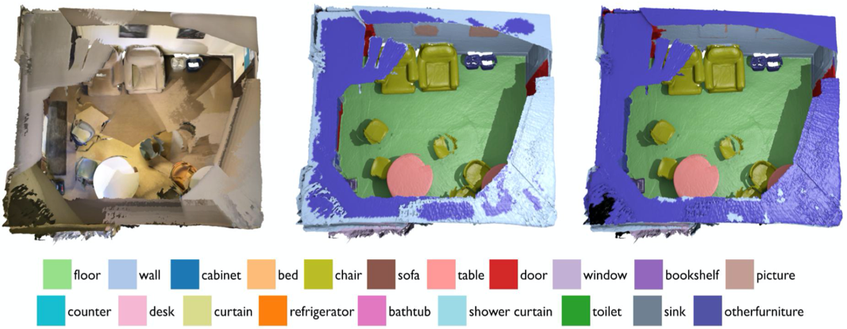
3D Semantic Segmentation

Slide 33
Previous works
“Place centric” methods (e.g. SparseConvNet)
😁 work well for types of objects with distinctive 3D shapes (e.g., chairs)
☹️ but not so well for others (e.g., wall pictures)

Slide 34
Previous works
“View centric” methods
🤕 Limitation of real photographic images:
Occlusion
lighting variation
camera pose misalignment
…

Slide 35
Solution
💡Using virtual views
Arbitrary viewpoints
Arbitrary numbers of views
Arbitrary camera intrinsics (e.g. higher field of view)
Physically impossible views (no lighting effects, see behind walls …)

Slide 36
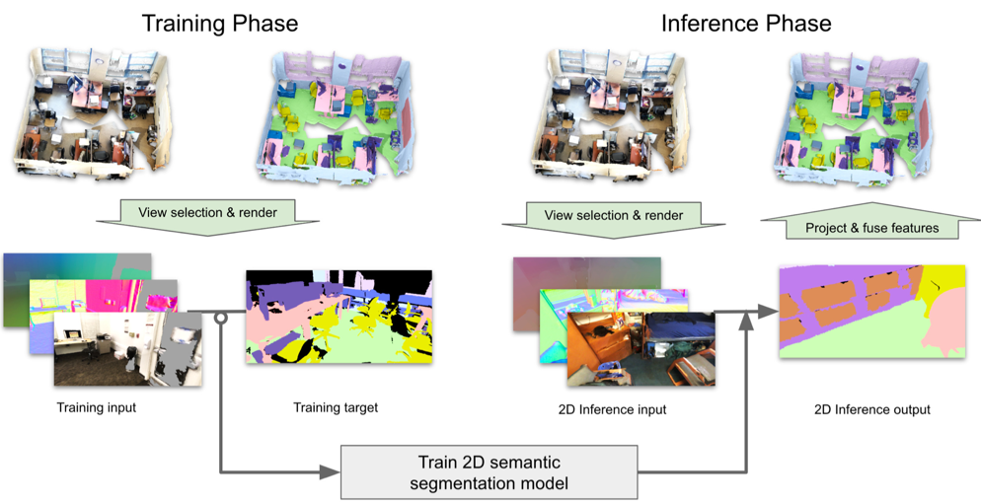
System Overview

Slide 37
System Overview

Slide 38
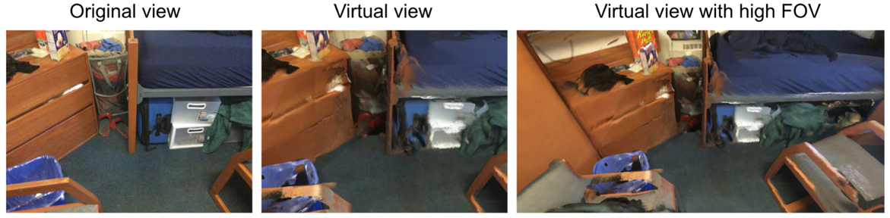
View selection - Camera intrinsics
Higher FOV provides larger context.

Slide 39
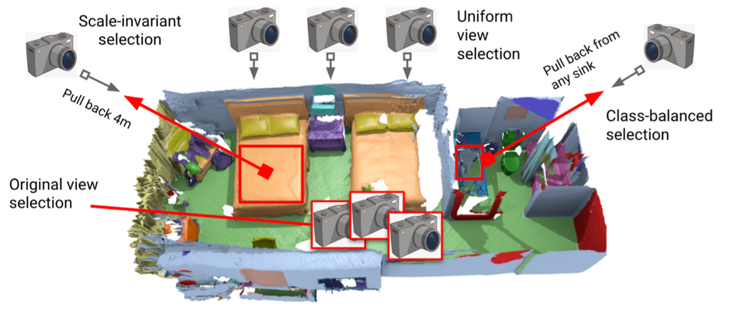
View selection - Camera extrinsics

Slide 40
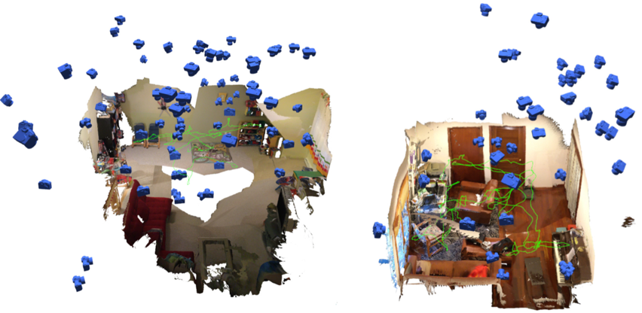
View selection - Camera extrinsics
Example virtual view selection on two ScanNet scenes

Slide 41
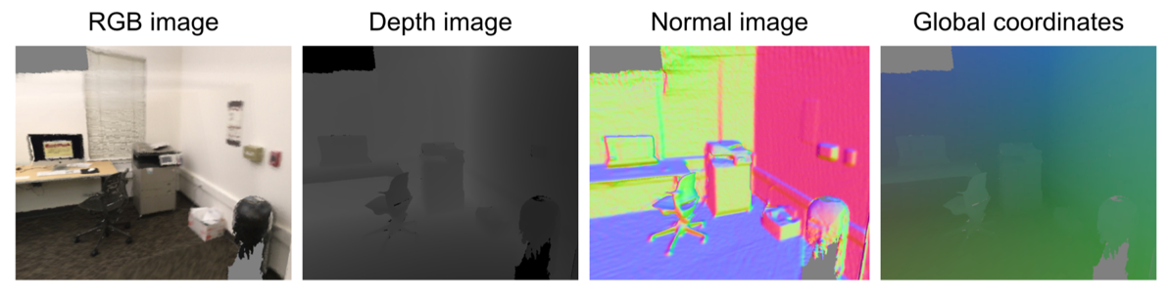
Rendering- additional channels
making the learning problem simpler

Slide 42
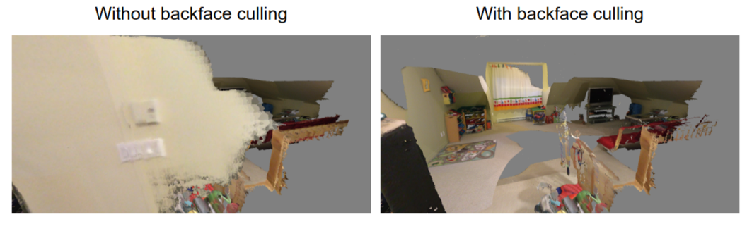
Rendering- backface culling
include more context of the room

Slide 43
System Overview

Slide 44
3D fusion of 2D semantic features
Steps:
3D points -> 2D pixel
Match: point-to-camera distance == pixel depth
Pros of 3D->2D projection:
no ray-casting needed
3D points << 2D pixels

Slide 45
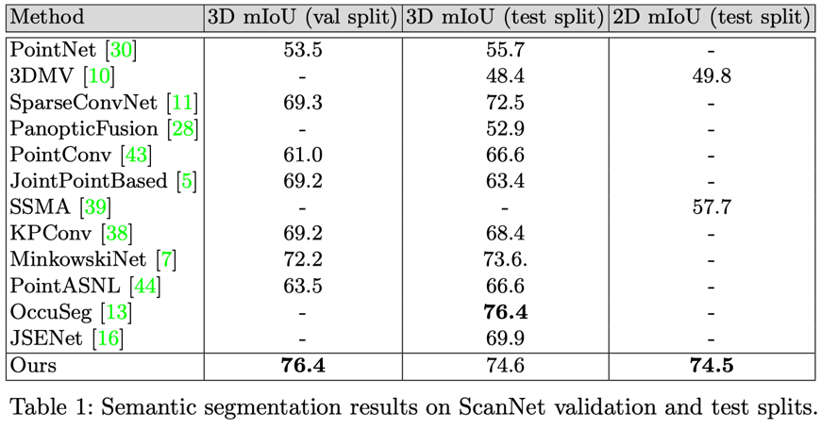
Experiments

Slide 46
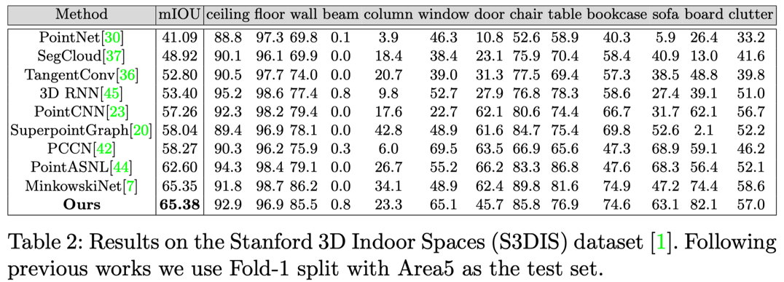
Experiments

Slide 47
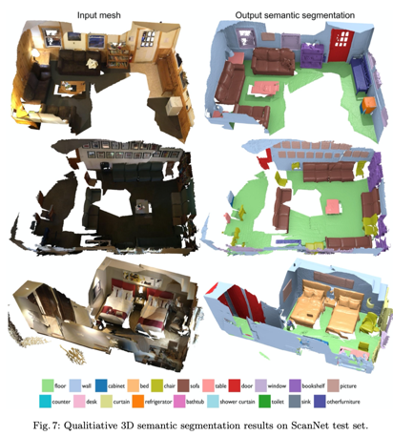
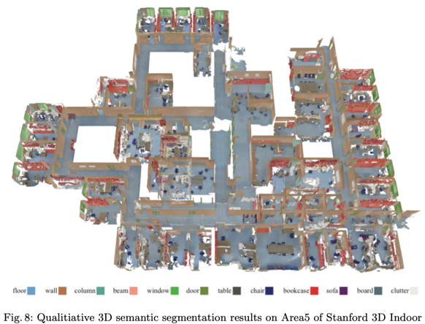
Experiments

Slide 48
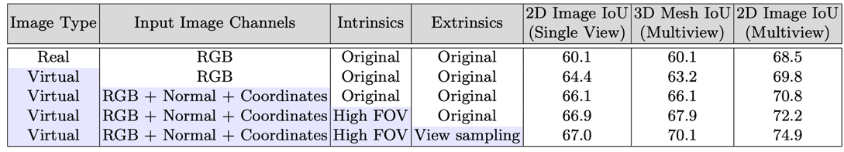
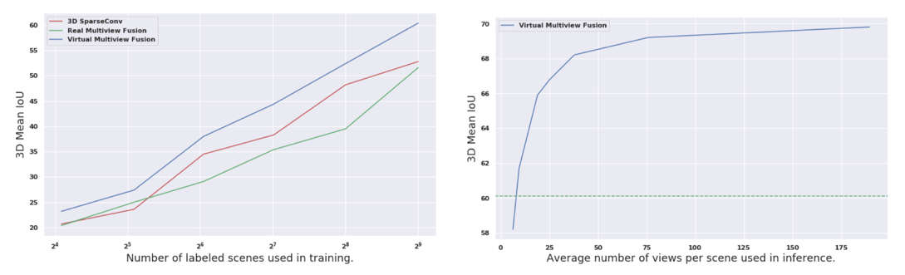
Experiments

Slide 49
Thanks

